Slide 1

Screen sequence diagram
CSE 110

Slide 2
Table of Contents
Login | 1
Register | 2
Menu | 3
Search | 4
Inventory | 5
Surprise Me | 6
Wine Meal Pairing | 7
Wish List | 8
Blood Alcohol Content | 9
Tutorial | 10

Slide 3
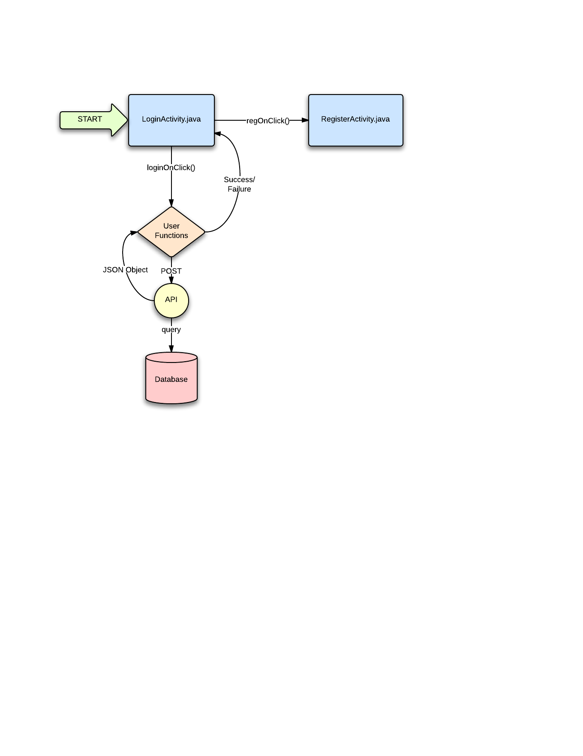
Login

Slide 4
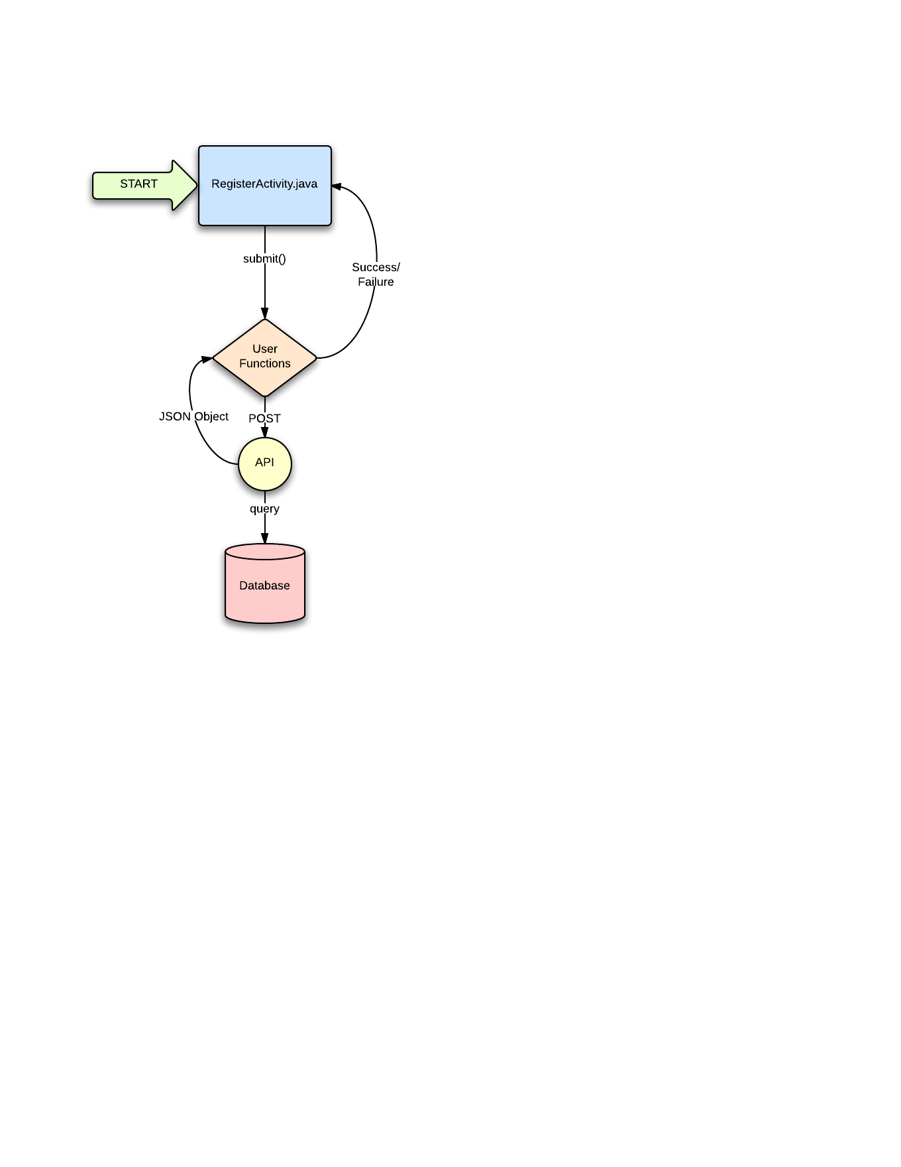
Register

Slide 5
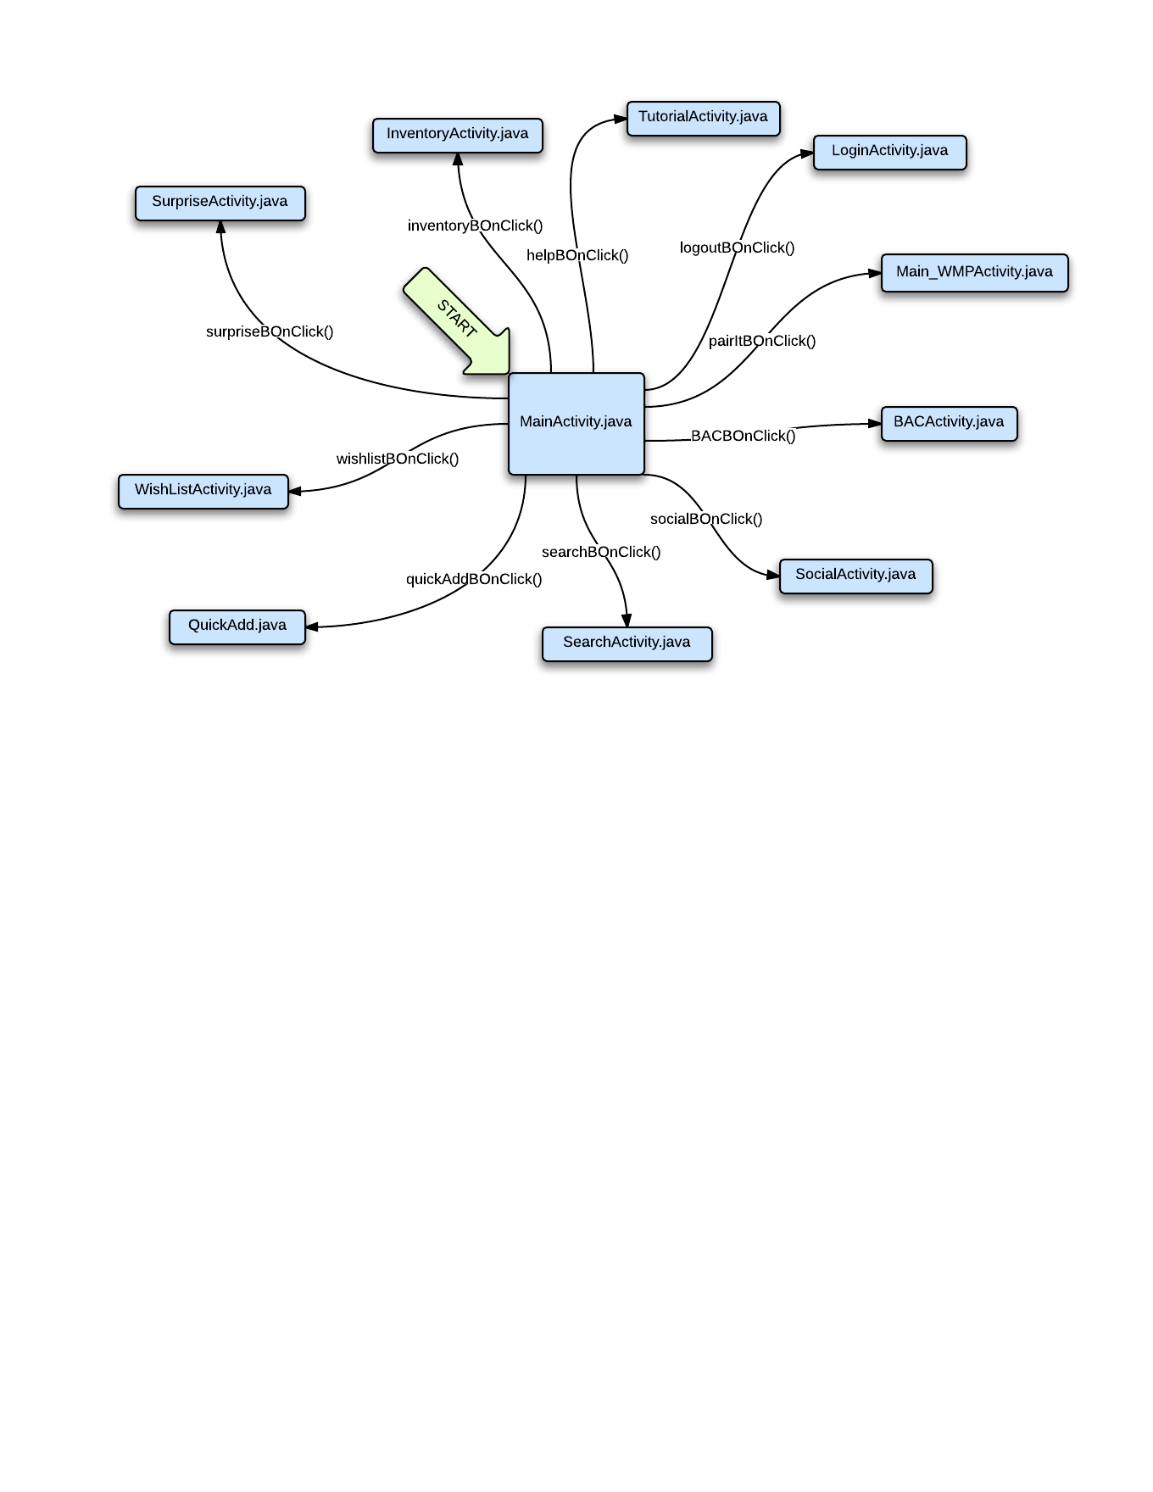
Menu

Slide 6
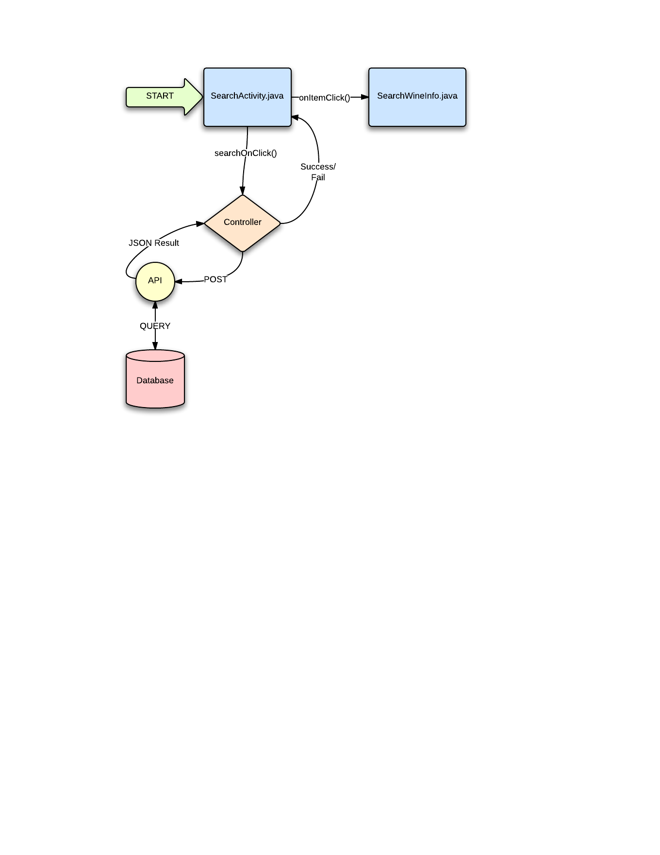
Search

Slide 7
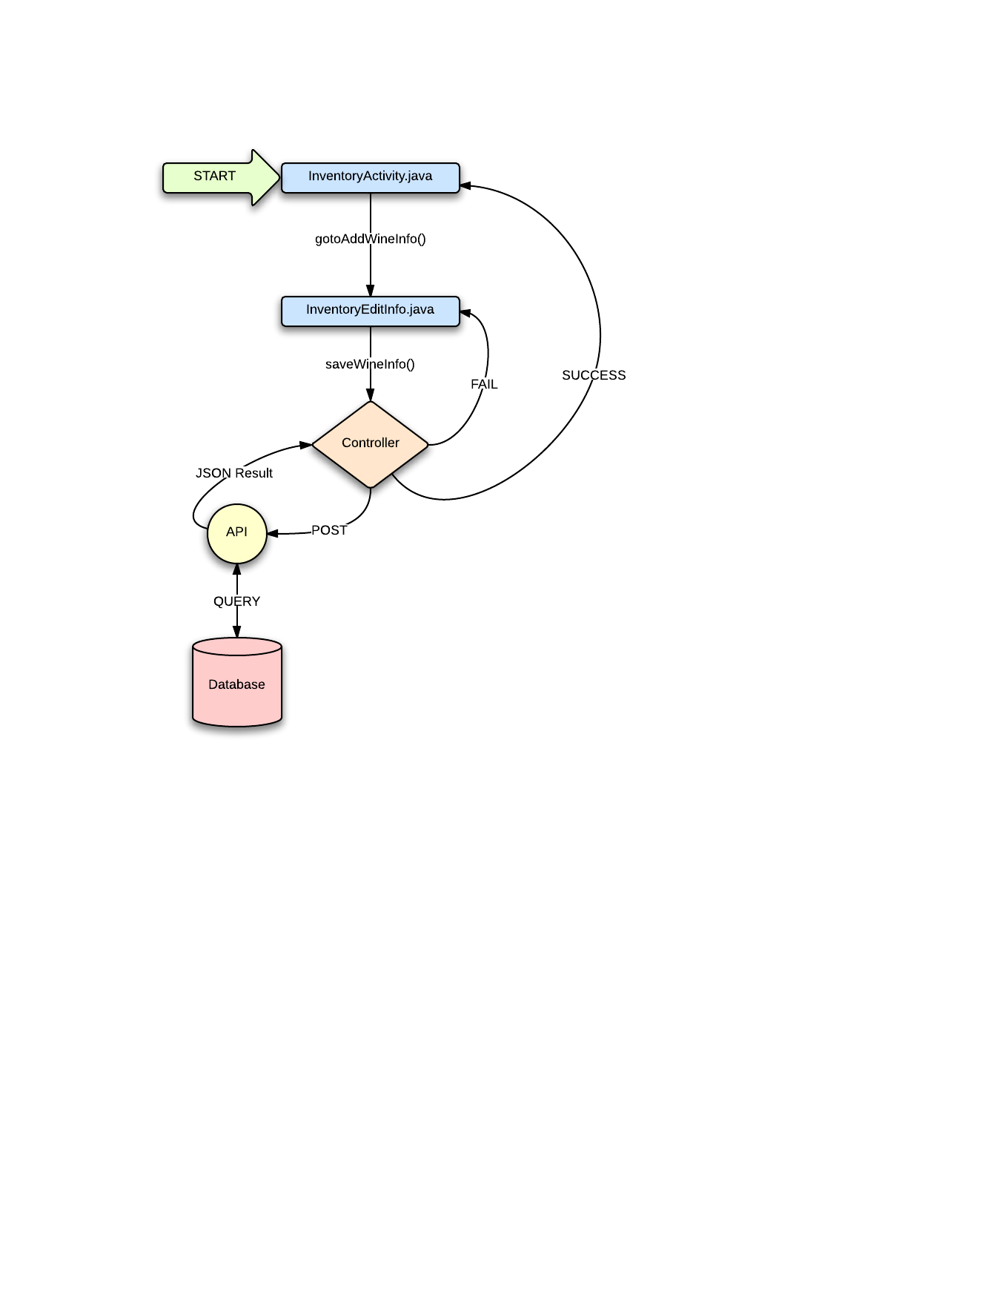
Inventory

Slide 8
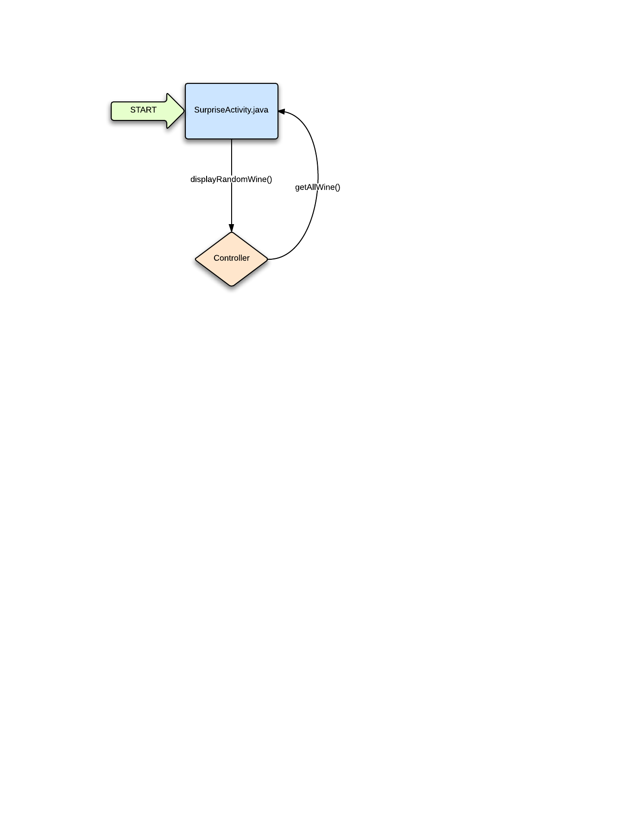
Surprise Me

Slide 9
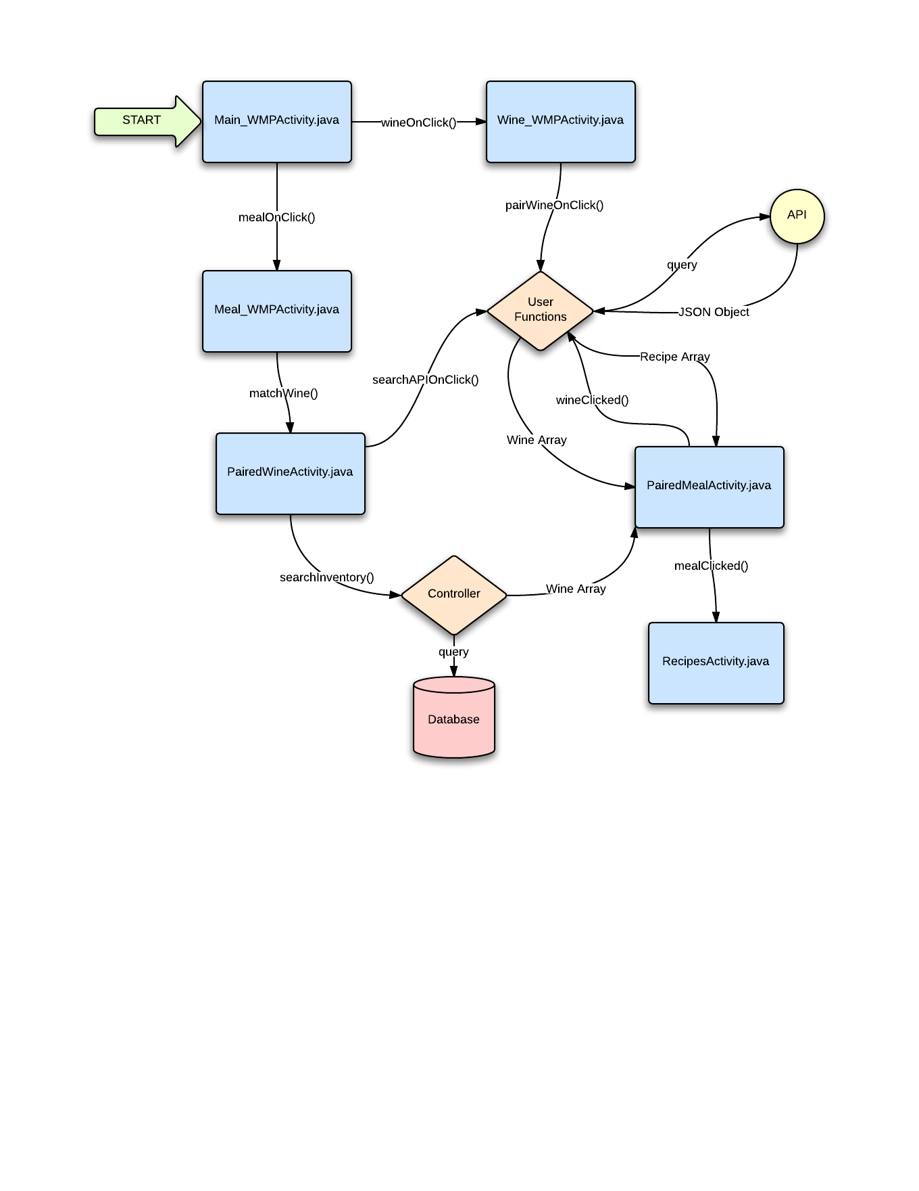
Wine Meal Pairing

Slide 10

Wish List

Slide 11

Blood Alcohol Content

Slide 12
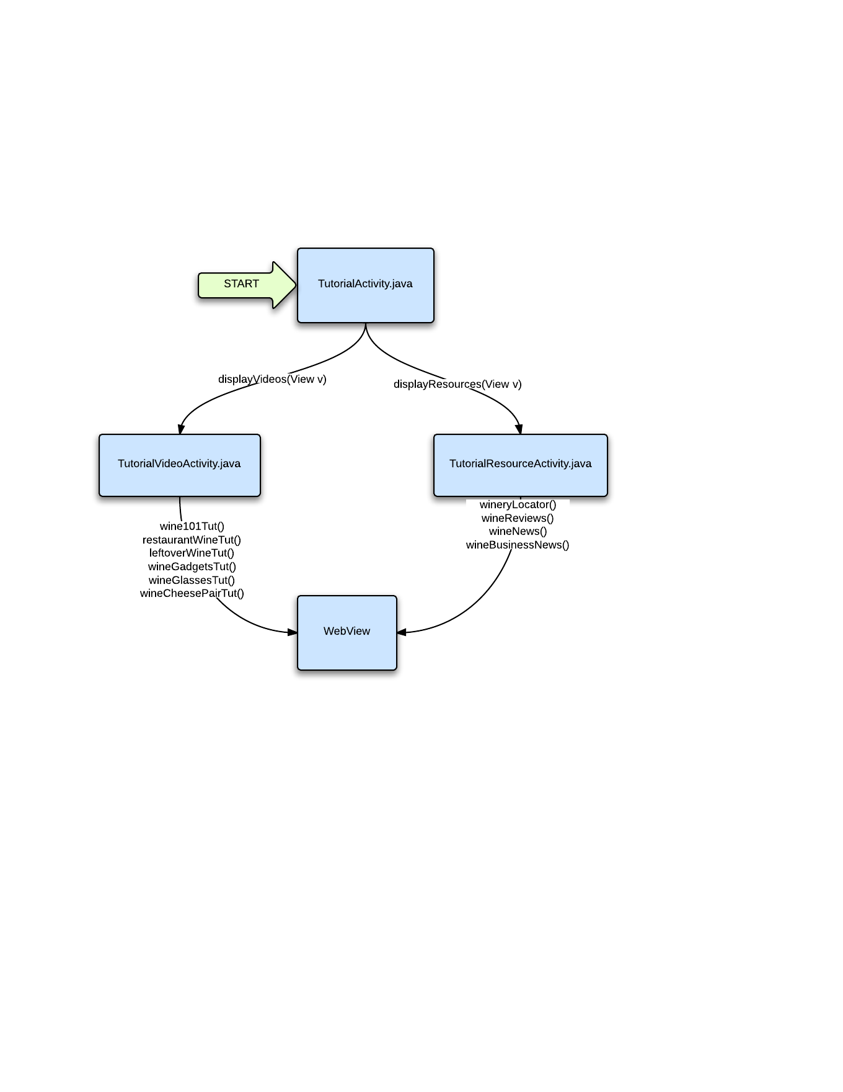
Tutorial

